Slide 1

Operating Systems Design 19CS2106R​ Session-9 File System Calls: creat, mknod, chdir and stat

Slide 2

Session Plan

Slide 3
Learning Outcomes
At the end of the session, the student will be able to:
Understand the file system calls creat, mknod, chdir and stat.
Understand above system calls as part of xv6 case study.
Design and Implementation of the above file.c

Slide 4
Creating a NEW File using creat ( )
The open system call gives a process access to an existing file, but the creat( ) system call creates a new file in the system.
The syntax for the creat( ) system call is
fd = creat(pathname, modes);
Here, the variables pathname, modes, and fd mean the same as they do in the open system call.

Slide 5
If no such file previously existed, the kernel creates a new file with the specified name and permission modes;
If the file already existed, the kernel truncates the file (releases all existing data blocks and sets the file size to 0) subject to suitable file access permissions.

Slide 6
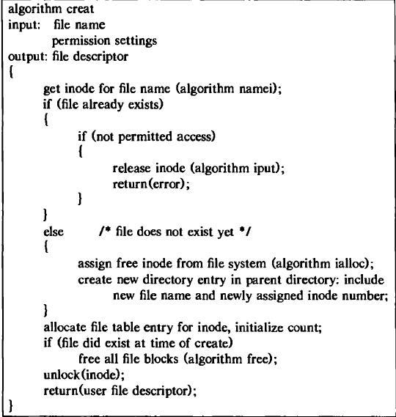
Algorithmic Design of creat( )

Slide 7
Creating Special Files using mknod( )
The system call mknod ( ) creates special files in the system, including named pipes, device files, and directories.
It is similar to creat in that the kernel allocates an inode for the file.
The syntax of the mknod ( )system call is
mknod(pathname, type and permissions, dev)
where pathname is the name of the node to be created, type and permissions give the node type (directory, for example) and access permissions for the new file to be created, and dev specifies the major and minor device numbers for block and character special files

Slide 8
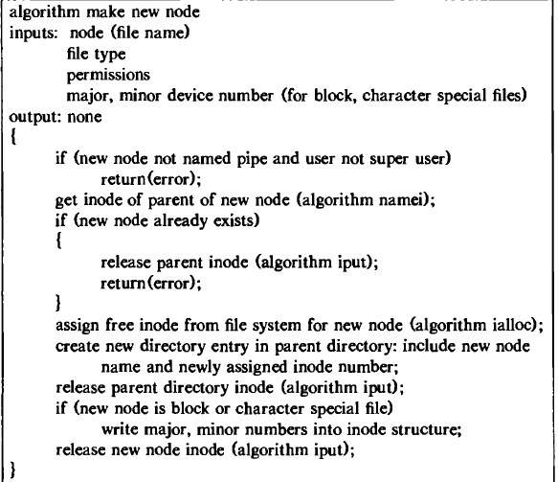
Algorithmic Design of mknod ( )

Slide 9
Changing current dierectory using chdir ( )
When the system is first booted, process 0 makes the file system root its current directory during initialization.
It executes the algorithm iget on the root mode, saves it in the u area as its current directory, and releases the mode lock.
When a new process is created via the fork system call, the new process inherits the current directory of the old process in its u area, and the kernel increments the mode reference count accordingly.

Slide 10
The syntax for the chdir ( ) system call is
chdir (pathname) ;
where pathname is the directory that becomes the new current directory of the process.

Slide 11
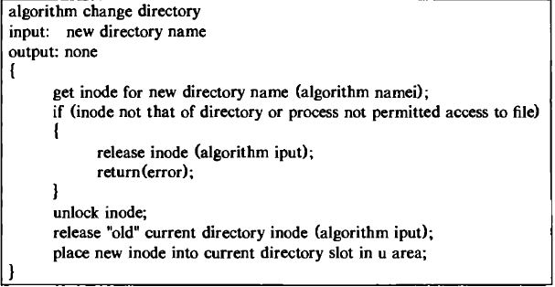
Algorithmic Design of chdir ( )

Slide 12
stat & fstat
The system calls stat and fstat allow processes to query the status of files and returning information such as the file type, file owner, access permissions, file size, number of links, mode number, and file access times

Slide 13
Syntax of stat ( ) & fstat ( )
stat (pathname, statbuffer) ;
fstat (fd, statbuffer);
where pathname is a file name, fd is a file descriptor returned by a previous open call, and statbuffer is the address of a data structure in the user process that will contain the status information of the file on completion of the call.
The system calls simply write the fields of the mode into statbuffer.

Slide 14
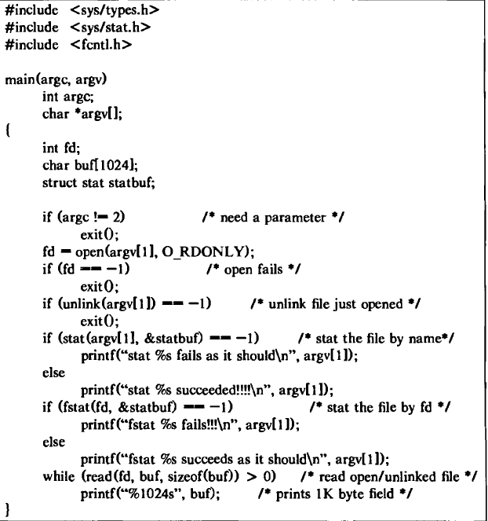
Implementation of stat ( ) & fstat( )

Slide 15
Case Study of xv6 Functions: creat, sys_mknod, sys_mkdir, sys_chdir and sys_fstat.

Slide 16
creat in xv6
The function create (6357)creates a new name for a new inode.
It is a generalization of the three file creation system calls: open with the O_CREATE flag makes a new ordinary file, mkdir makes a new directory, and mkdev makes a new device file.
Using create, it is easy to implement sys_open, sys_mkdir, and sys_mknod.

Slide 17
chdir and sys_chdir in xv6
In xv6, The directories form a tree, starting at a special directory called the root.
A path like /a/b/c refers to the file or directory named c inside the directory named b inside the directory named a in the root directory /.
Paths that don’t begin with / are evaluated relative to the calling process’s current directory, which can be changed with the chdir system call.

Slide 18
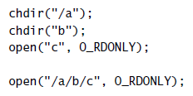
chdir in xv6

Slide 19
mkdir, mknod and sys_mkdir & sys_mknod in xv6
There are multiple system calls to create a new file or directory:
mkdir creates a new directory, open with the O_CREATE flag creates a new data file and
mknod creates a new device file.

Slide 20


Slide 21
Here, mknod creates a file in the file system, but the file has no contents.
Instead, the file’s metadata marks it as a device file and records the major and minor device numbers (the two arguments to mknod), which uniquely identify a kernel device.
When a process later opens the file, the kernel diverts read and write system calls to the kernel device implementation instead of passing them to the file system.

Slide 22
fstat in xv6
fstat retrieves information about the object a file descriptor refers to.
In xv6, it will be handled as follows:
#define T_DIR 1 // Directory
#define T_FILE 2 // File
#define T_DEV 3 // Device
struct stat {
short type; // Type of file
Int dev; // File system’s disk device
uint ino; // Inode number
short nlink; // Number of links to file
uint size; // Size of file in bytes
};

Slide 23
Design and implementation of file.c
https://github.com/mit-pdos/xv6-public/blob/master/file.c

Slide 24
file.c is a github repository on file related activities and operations.
Consists of 157 lines of xv6 code.

Slide 25
file.c consists of xv6 code implementations of
File Descriptors
Allocation of File Structures
Incrementing the ref.count for file f
Close operation of file f
Getting metadata about file f
Reading from file f
Writing to file f

Slide 26
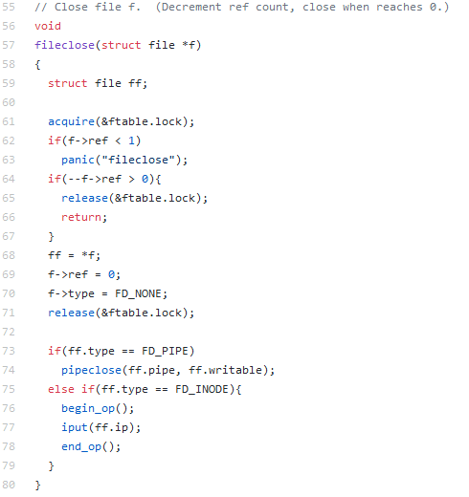
Closing a file f

Slide 27
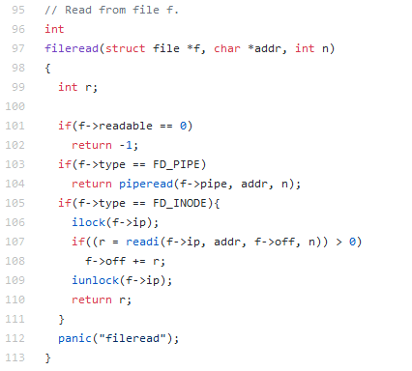
Reading from a file

Slide 28
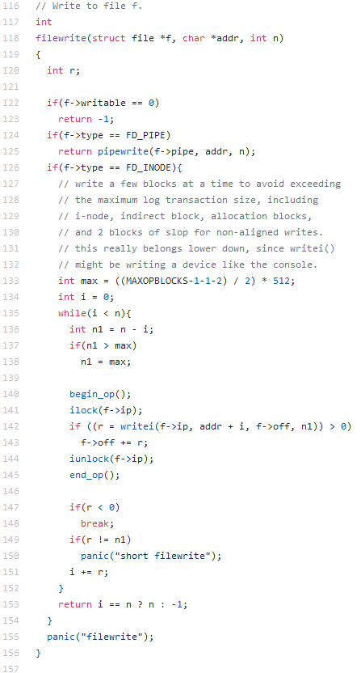
Writing to file f

